Slide 1
Steam

Slide 2
Contents
What is Steam?
Types of steam
How steam is Generated?
Properties of Steam
How to make Property diagrams (P-V, T-S ) for steam?
Steam Tables and Mollier Chart

Slide 3
What is Steam?
Steam is liquid water changed to its vapour phase/state. Steam is produced by heating water above its boiling point temperature.
Steam is an invisible vapour/ gas created by adding heat energy to water.
Saturated steam - Steam in immediate contact with the water from which it is being generated.
Steam is a versatile and widely-used working fluid that is used in a variety of applications in mechanical, chemical, pharmaceutical, textile manufacturing, dairy and many more industries.
Steam has many important applications in mechanical engineering, including power generation (thermal power), heating, and refrigeration, medical therapy.

Slide 4
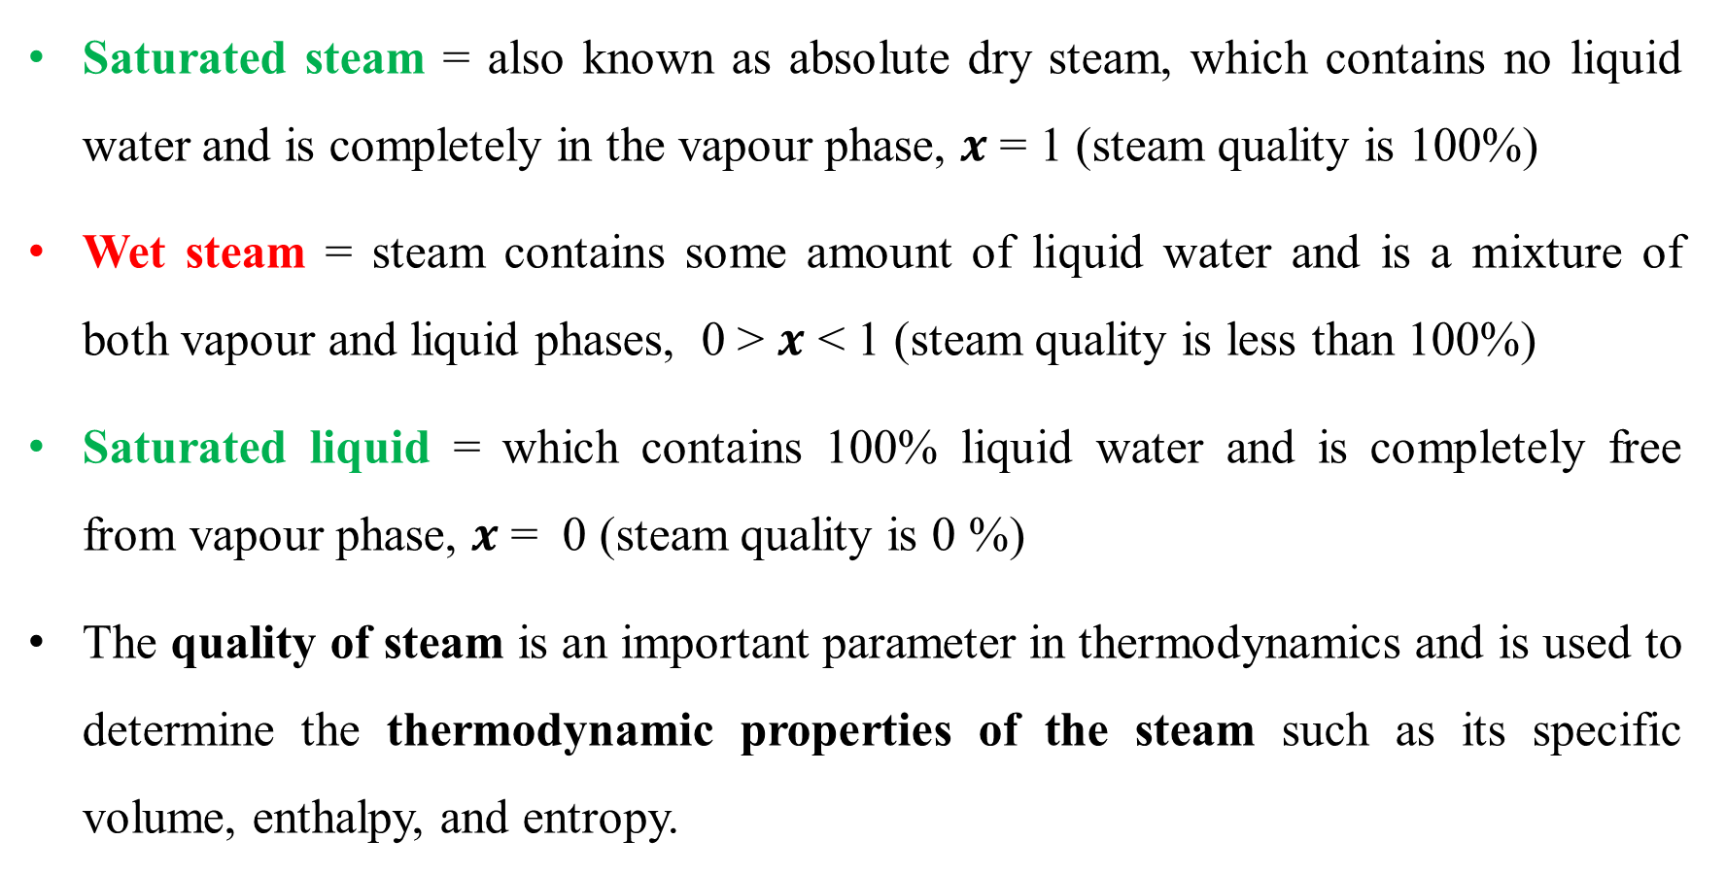
Different types of steam
Saturated steam = also known as absolute dry steam, which contains no liquid water and is completely in the vapour phase, $x$ = 1 (steam quality is 100%)
Wet steam = steam contains some amount of liquid water and is a mixture of both vapour and liquid phases, 0 > $x$ < 1 (steam quality is less than 100%)
Saturated liquid = which contains 100% liquid water and is completely free from vapour phase, $x$ = 0 (steam quality is 0 %)
The quality of steam is an important parameter in thermodynamics and is used to determine the thermodynamic properties of the steam such as its specific volume, enthalpy, and entropy.

Slide 5
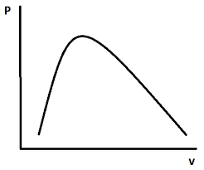
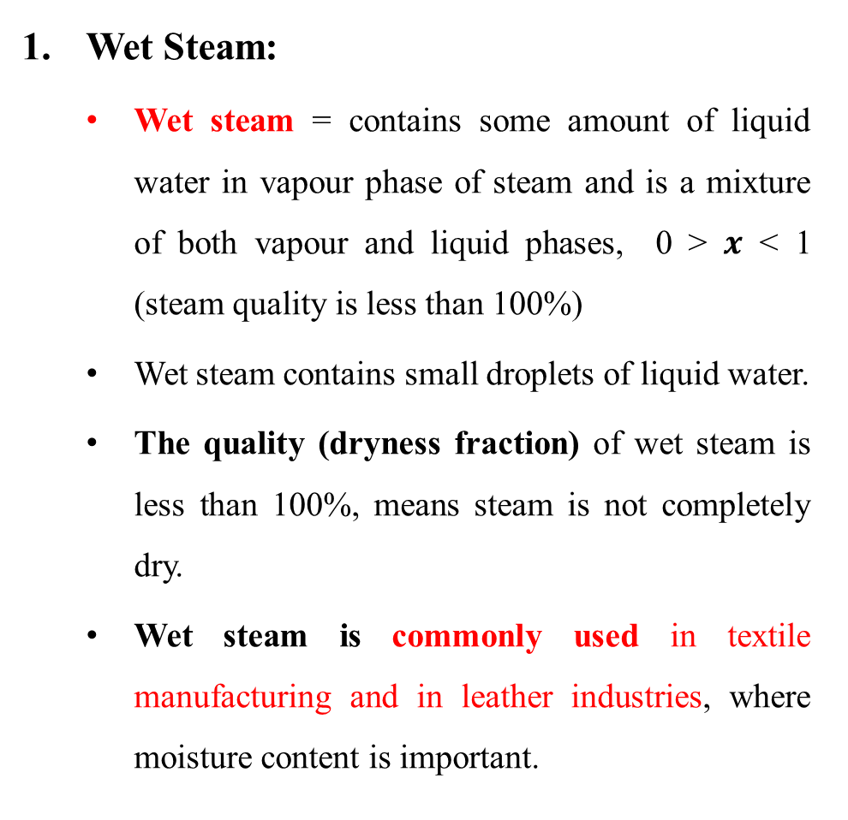
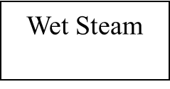
Types of Steam
Wet Steam:
Wet steam = contains some amount of liquid water in vapour phase of steam and is a mixture of both vapour and liquid phases, 0 > $x$ < 1 (steam quality is less than 100%)
Wet steam contains small droplets of liquid water.
The quality (dryness fraction) of wet steam is less than 100%, means steam is not completely dry.
Wet steam is commonly used in textile manufacturing and in leather industries, where moisture content is important.
Saturated Liquid Line
Critical Point
Saturated Vapour Line
Sub-cooled Liquid
Superheated Steam
Wet Steam
0 > $x$ < 1
Fig: Different Types of Steam

Slide 6
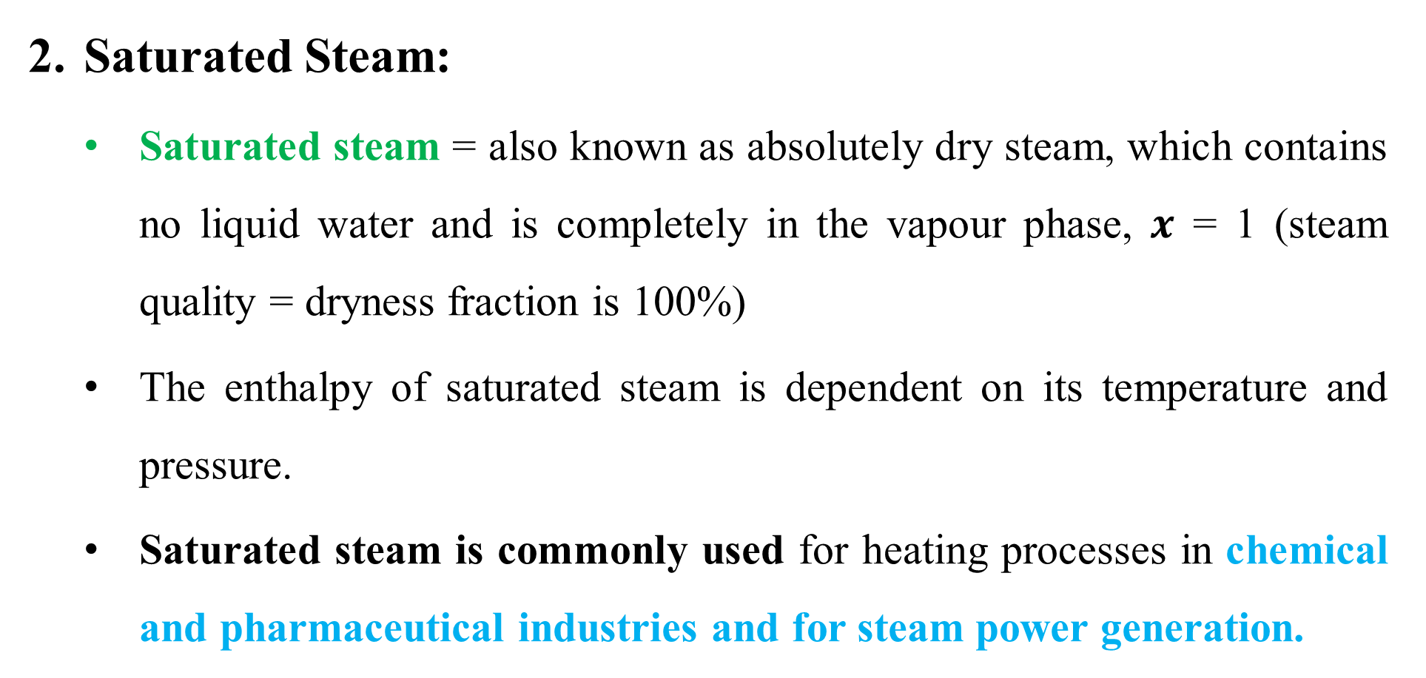
Saturated Steam
Saturated Steam:
Saturated steam = also known as absolutely dry steam, which contains no liquid water and is completely in the vapour phase, $x$ = 1 (steam quality = dryness fraction is 100%)
The enthalpy of saturated steam is dependent on its temperature and pressure.
Saturated steam is commonly used for heating processes in chemical and pharmaceutical industries and for steam power generation.

Slide 7
Superheated Steam
Superheated Steam:
Superheated steam contains no liquid water droplets and steam is completely in the vapour phase.
Superheated steam is obtained when it is heated above its saturation point temperature at constant pressure.
Superheated steam has a higher energy content than saturated steam and is commonly used in steam based power plants and in many industrial processes.

Slide 8
How Steam is Generated From Water?
Steam is generated from water through a process called vaporization or boiling, in which water is heated to boiling point temperature and converted into steam.
Stages of steam generation process at 1 atmospheric pressure (1.01325 Bar)
Sensible heating of ice from -10ºC to 0ºC
Melting of ice (say from 0ºC to 0ºC)
Sensible heating of water from 0ºC up to boiling point (100ºC)
Latent heating of water to form steam at saturation temp i.e. at boiling point (100ºC)
Super heating of steam (from 100ºC up to 250ºC) at constant pressure of 1.01325 Bar

Slide 9
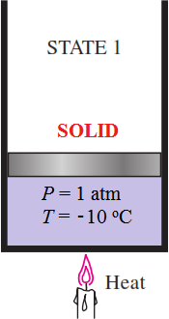
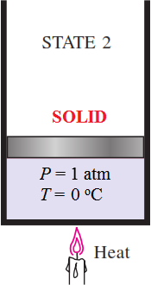
Experiment to Generate Steam
Consider 1 kg of ice, in a piston-cylinder, at 1 standard atm pressure (which is kept constant) and at -10ºC temperature. Water exists in solid phase (i.e. ice of -10ºC ). Water is in state 1.
Now, supply heat ‘Q’ while pressure remains constant
Sensible heating Process 1-2: Sensible heating of ice from
-10ºC (state 1) temperature to 0º C (state 2).
In this process volume of Ice Increases.

Slide 10
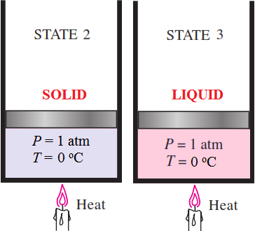
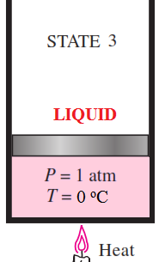
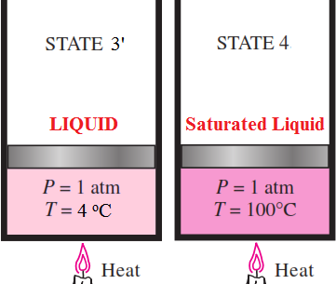
Latent heating Process 2-3: Further heating Causes melting of Ice at 0ºC
Temperature remains constant 0ºC (also at constant pressure of 1 atmosphere)
Volume of ice decreases
Solid Phase of water (state 2) is changed to Liquid phase (state 3)
Sensible heating Process 3-4: Heating of water Causes temperature rise until it starts boiling
Volume Decreases (minima at 4ºC (at state 3’, Peculiarity of water)
and then increases from state 3’ to state 4

Slide 11
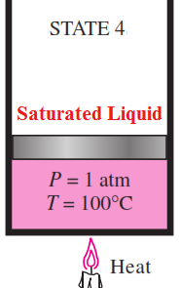
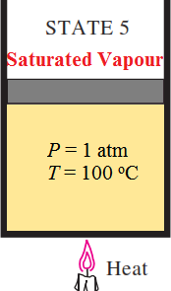
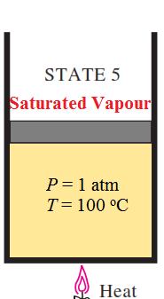
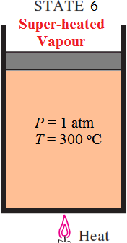
Latent heating Process 4-5: Further Heating Causes Vapourization of Liquid at 100ºC
Phase changes from liquid (state 4) to vapour (state 5) at constant temperature of 100ºC and pressure of 1 atm.
Volume Increases significantly in this process
Sensible heating Process 5-6: Heating dry saturated steam (state 5) produces superheated steam (state 6)
Both temperature and Volume increases during superheating.
But pressure remains constant at 1 atm pressure

Slide 12
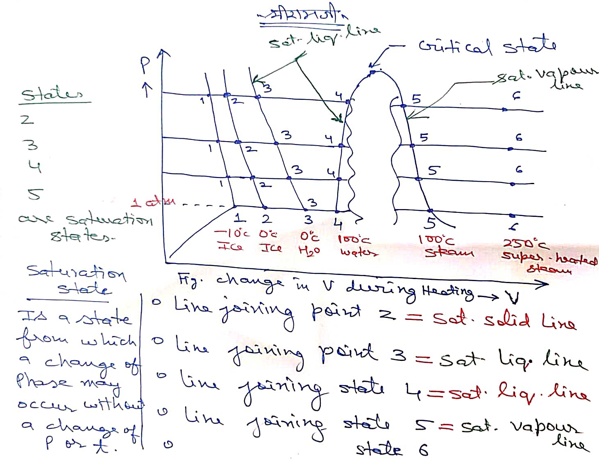

Slide 13
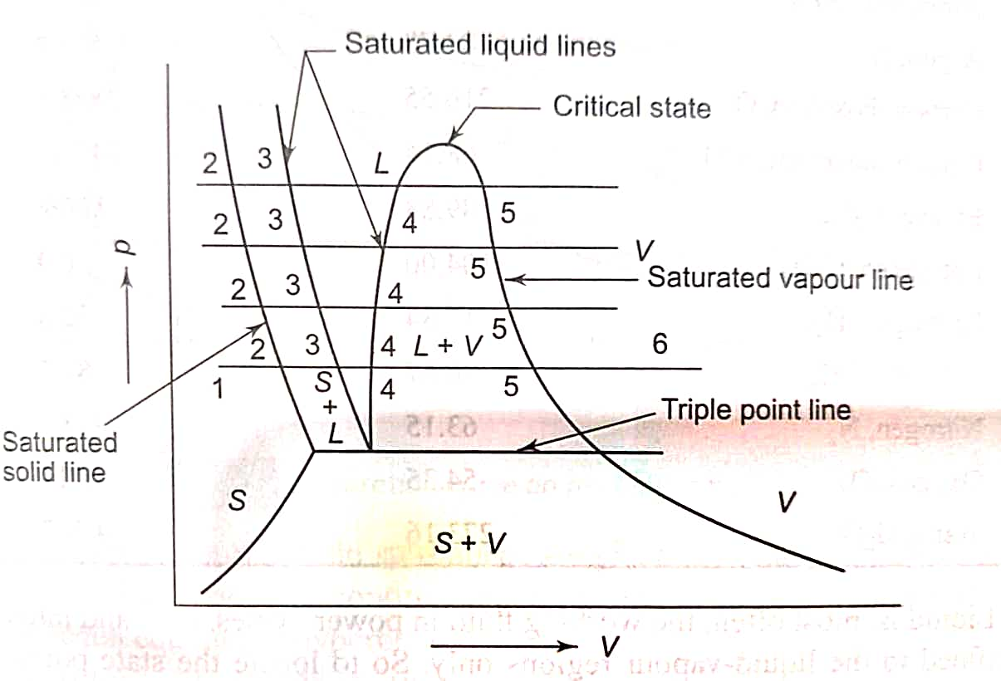
Phase equilibrium diagram on P-V plot
Point at which all three phases (solid, liquid and gaseous) co-exist is referred as triple point
For water,
T_{tp} = 0.01ºC and
P_{tp} = 0.00611 bar

Slide 14
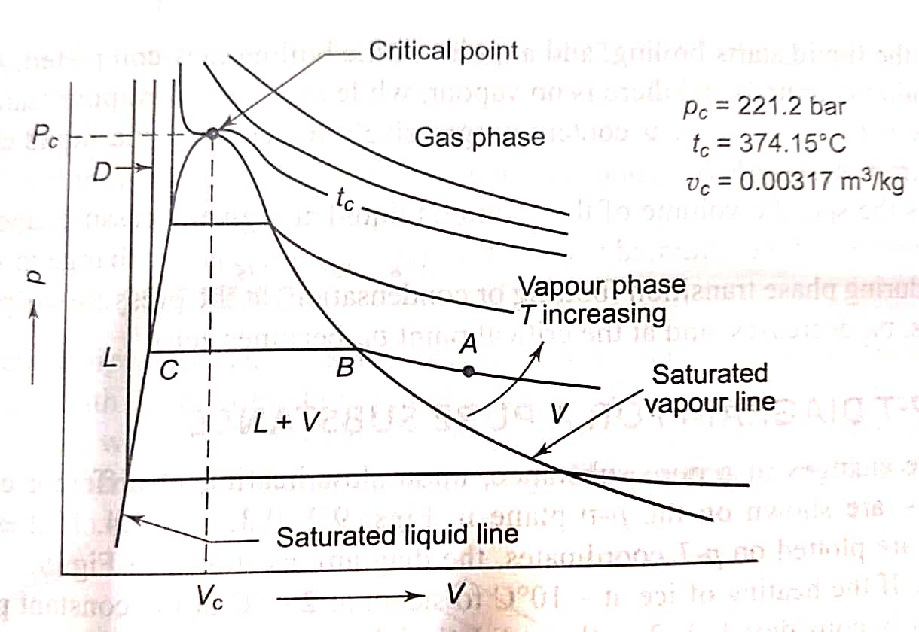
Pressure Volume (P-V) Diagram
P-V diagram is a useful tool for understanding the behavior of water and steam under different conditions.
Area inside the Dome represents the Quality (dryness fraction) region i.e., wet steam.
Critical point is at the peak of saturation dome
T_{CR} = 374ºC and
P_{CR}= 221.2 bar
Y- Axis has Pressure and X-Axis has Volume.

Slide 15
Property P-V Diagram
Note these lines on P-V diagram
Saturated liquid line
Saturated vapour line
Liquid - vapour dome
Critical point
Superheated region
Gas phase beyond CP

Slide 16
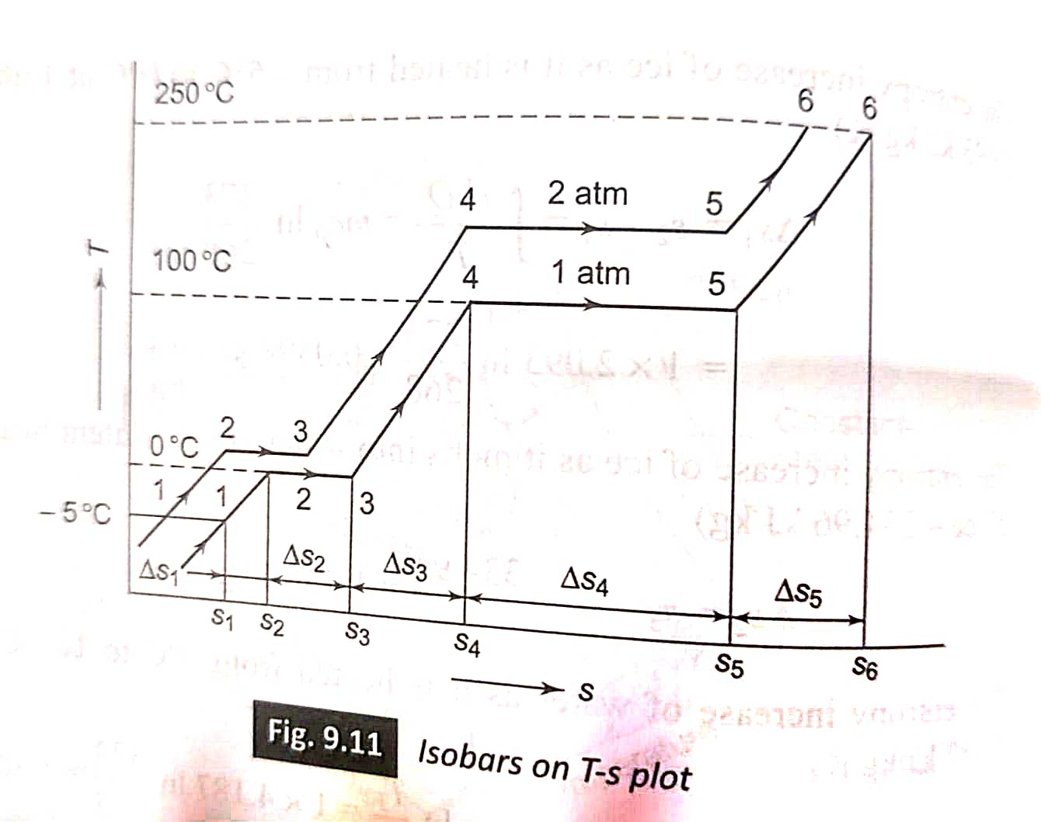
Isobars on T-S plot
Isobars on T-S plot during experimental study of heating Ice from -10ºC up to steam (at 250ºC) formation.
Saturated solid state= 2
Saturated liquid state = 3 and 4
Saturated vapour state = 5
Liquid - vapour dome between 4 and 5
Superheated region beyond point 5

Slide 17
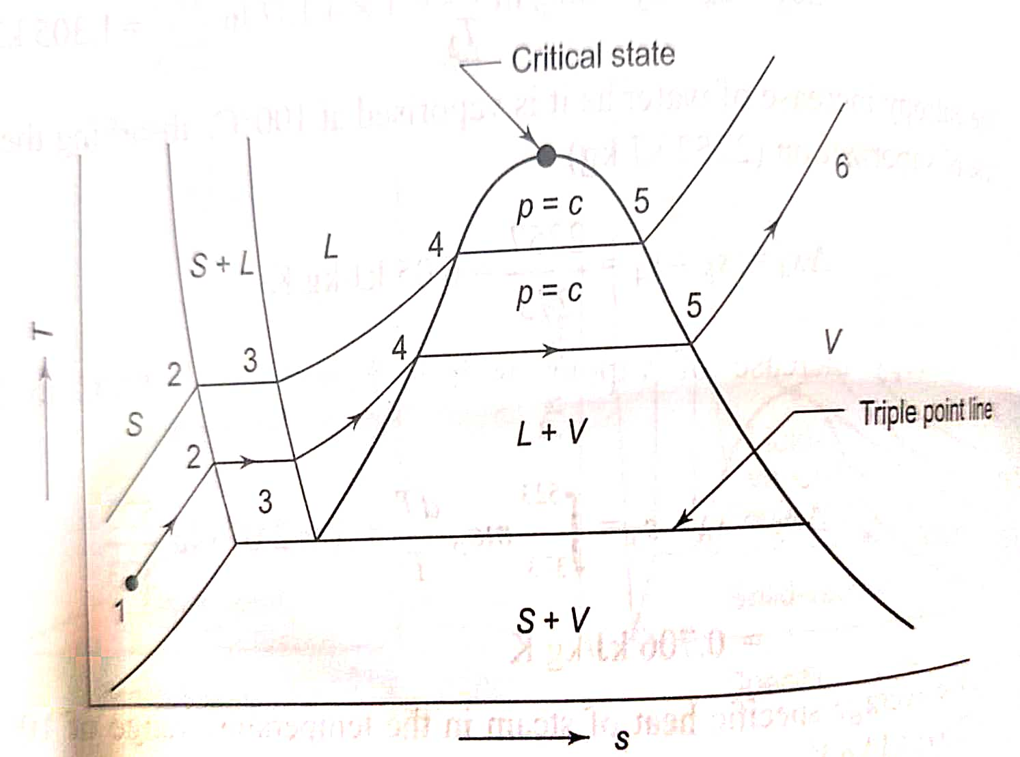
Phase equilibrium diagram on T-S plot
Note these lines on T-S diagram
Saturated liquid line (locus of point 3 and 4)
Saturated vapour line (locus of state 5)
Liquid - vapour dome (between state 4 and 5)
Critical point
Superheated region beyond state 5
Gas phase beyond CP

Slide 18
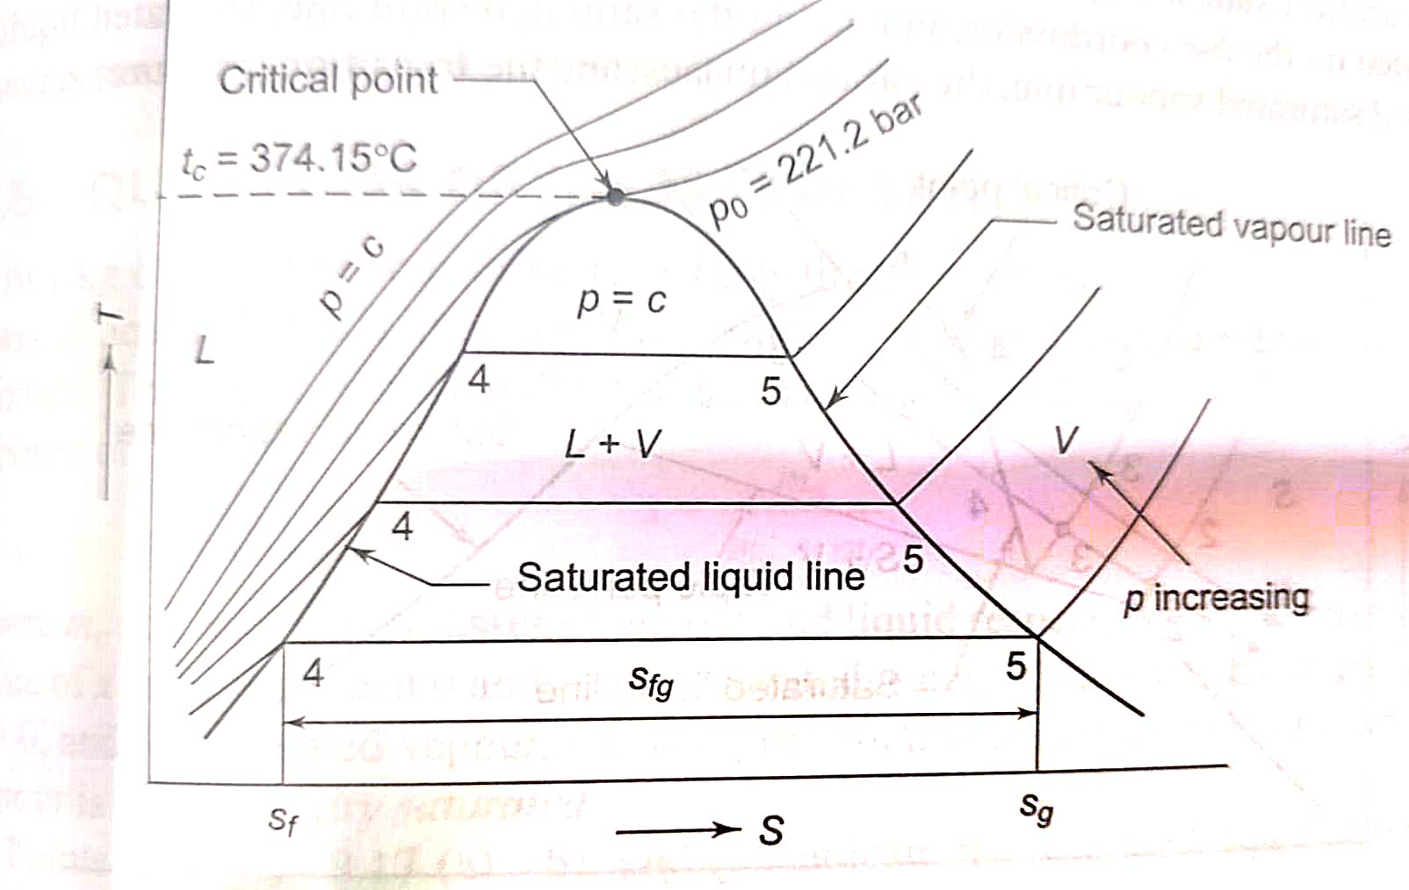
Temperature Entropy Diagram
Using T-s diagram in combination with the saturation properties makes thermodynamic analysis of a process (or cycle) easier
Locus of sat. liquid & sat. vapour points meet at different pressures to create a dome which divides the data into three distinct regions (i.e. sub-cooled, wet vapour and superheated regions)
Critical point (C.P) lies at the peak of saturation dome and Latent Heat of Vapourization is zero at the critical point

Slide 19
Saturation dome for water on T-S plot
Carefully note these lines on
T-S diagram
Saturated liquid line
Saturated vapour line
Liquid - vapour dome
Critical point
Superheated region
Constant pressure lines

Slide 20
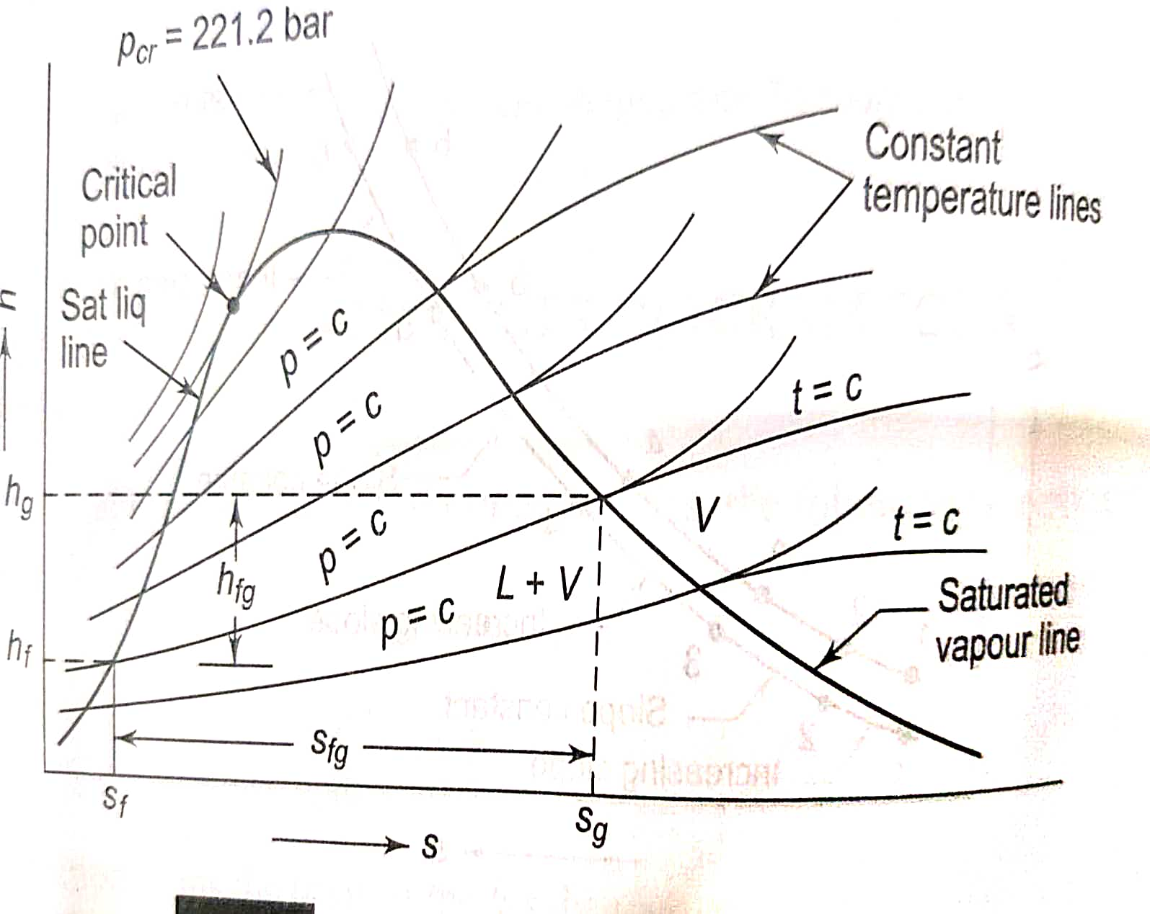
Enthalpy-entropy (h-s) diagram for water
Carefully note these lines on h-s diagram
Saturated liquid line
Saturated vapour line
Liquid - vapour dome
Critical point
Superheated region
Constant pressure lines
Mollier chart for water

Slide 21
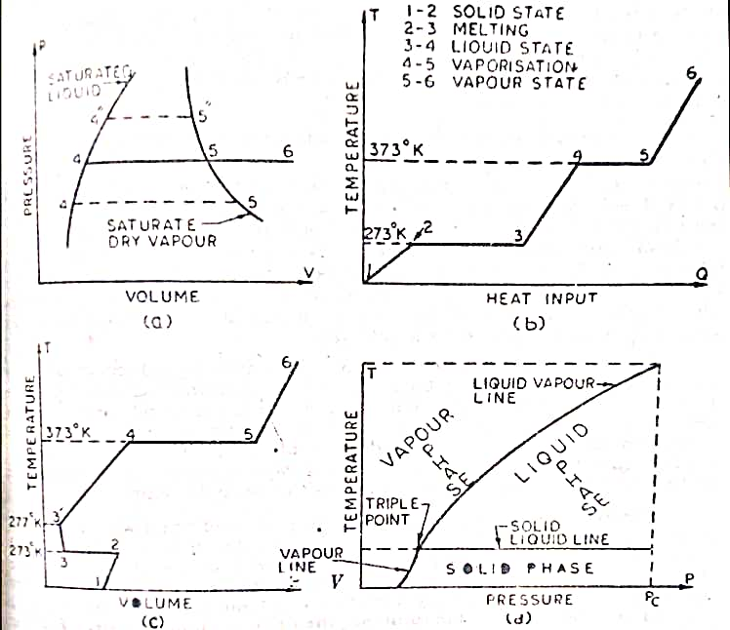
Formation of Steam
Diagrams represent Formation of Steam from state 1 to 6 (For 1 kg mass of water at constant 1 atm. Pressure).
Melting of ice from 2 to 3
Liquid phase between 3 and 4
The starting point of Boiling is indicated by point 4 on the diagrams. (at constant P and T)
Water Evaporates till point 5.
After 5 it is superheated.

Slide 22
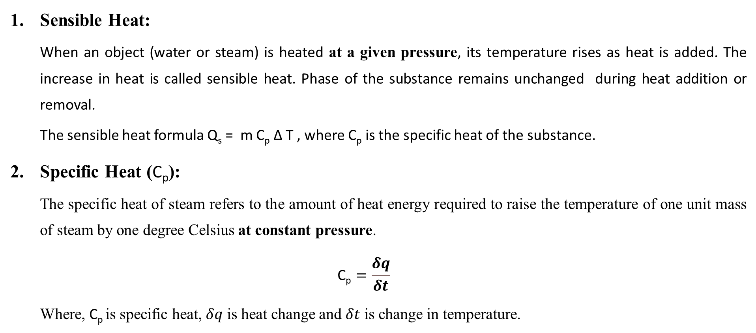
Properties of Steam
Sensible Heat:
When an object (water or steam) is heated at a given pressure, its temperature rises as heat is added. The increase in heat is called sensible heat. Phase of the substance remains unchanged during heat addition or removal.
The sensible heat formula Q_{s} = m C_{p} Δ T , where C_{p} is the specific heat of the substance.
Specific Heat (C_{p}):
The specific heat of steam refers to the amount of heat energy required to raise the temperature of one unit mass of steam by one degree Celsius at constant pressure.
$$\text{C}\text{p}=\frac{δq}{δt}$$
Where, C_{p} is specific heat, $δq$ is heat change and $δt$ is change in temperature.

Slide 23
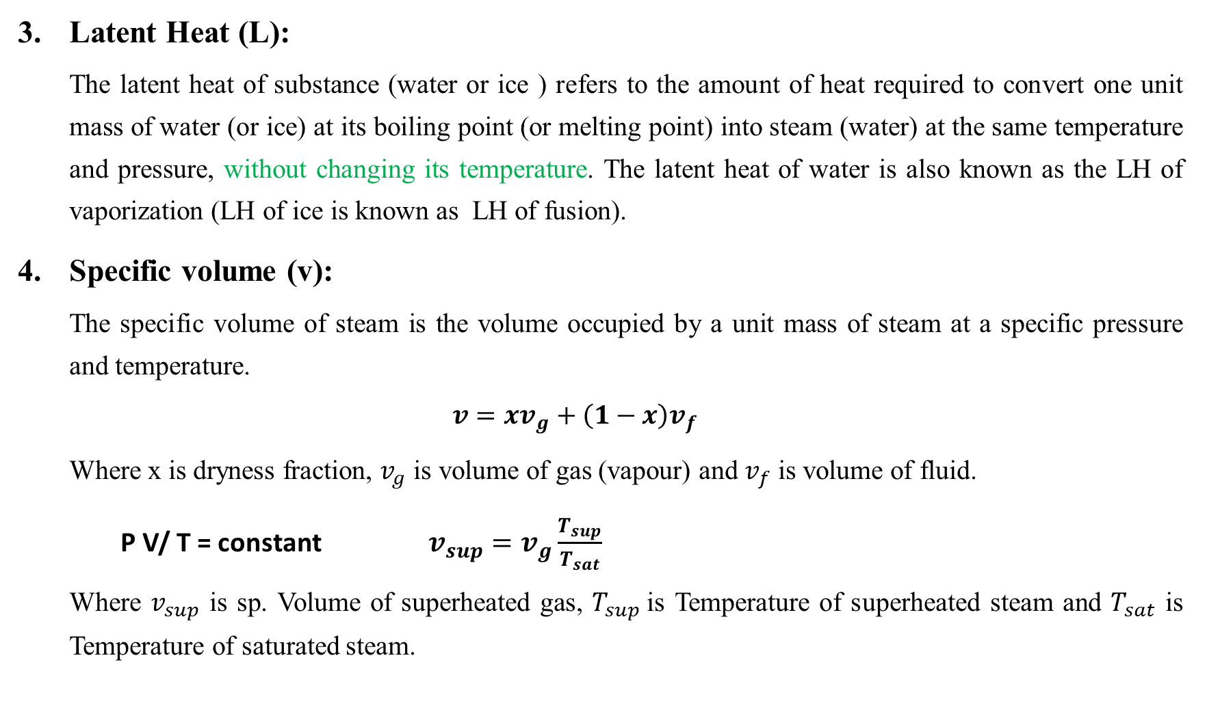
Latent Heat (L):
The latent heat of substance (water or ice ) refers to the amount of heat required to convert one unit mass of water (or ice) at its boiling point (or melting point) into steam (water) at the same temperature and pressure, without changing its temperature. The latent heat of water is also known as the LH of vaporization (LH of ice is known as LH of fusion).
Specific volume (v):
The specific volume of steam is the volume occupied by a unit mass of steam at a specific pressure and temperature.
$$v=xv_{g}+\left(1−x\right)v_{f}$$
Where x is dryness fraction, $v_{g}$ is volume of gas (vapour) and $v_{f}$ is volume of fluid.
P V/ T = constant $v_{sup}=v_{g}\frac{T_{sup}}{T_{sat}}$
Where $v_{sup}$ is sp. Volume of superheated gas, $T_{sup}$is Temperature of superheated steam and $T_{sat}$ is Temperature of saturated steam.

Slide 24

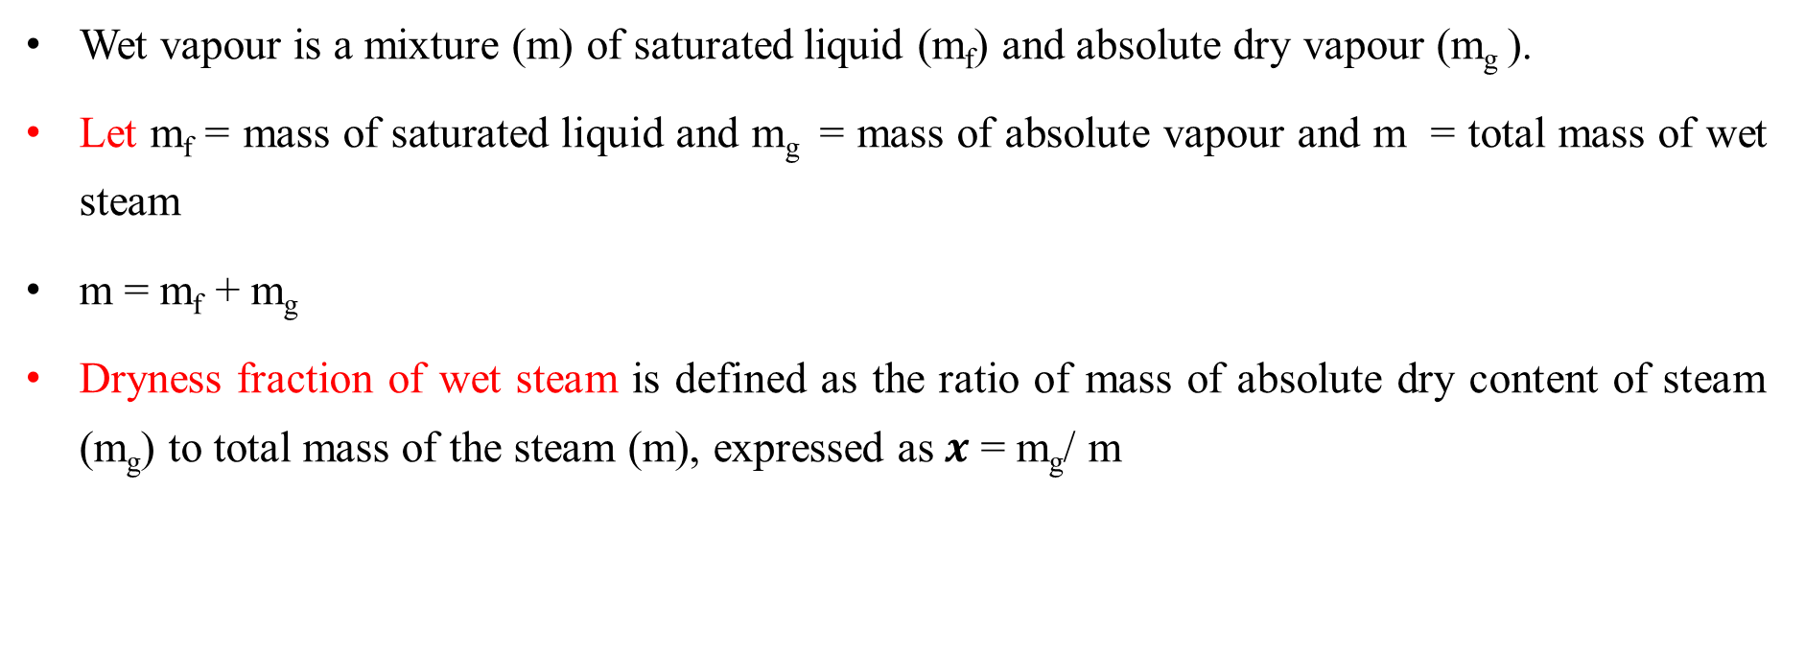


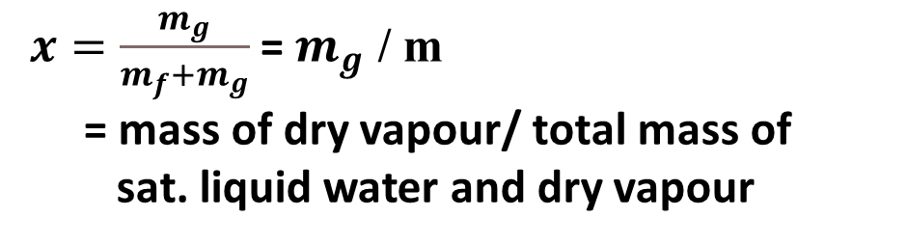
Quality (Dryness fraction) of Steam
Wet vapour is a mixture (m) of saturated liquid (m_{f}) and absolute dry vapour (m_{g} ).
Let m_{f} = mass of saturated liquid and m_{g} = mass of absolute vapour and m = total mass of wet steam
m = m_{f} + m_{g}
Dryness fraction of wet steam is defined as the ratio of mass of absolute dry content of steam (m_{g}) to total mass of the steam (m), expressed as $x$ = m_{g}/ m
Critical point
Saturated vapour line
$x=\frac{m_{g}}{m_{f}+m_{g}}$ = $m_{g}$ / m
= mass of dry vapour/ total mass of
sat. liquid water and dry vapour
Saturated liquid line
$$x=0$$
$$x=1$$
$0<x$<1

Slide 25
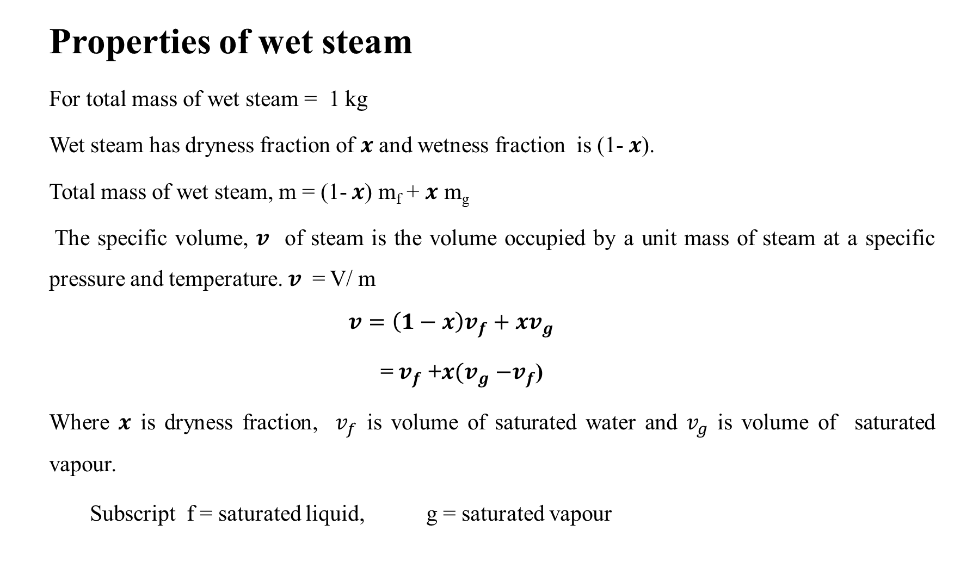
Properties of wet steam
For total mass of wet steam = 1 kg
Wet steam has dryness fraction of $x$ and wetness fraction is (1- $x$).
Total mass of wet steam, m = (1- $x$) m_{f} + $x$ m_{g}
The specific volume, $v$ of steam is the volume occupied by a unit mass of steam at a specific pressure and temperature. $v$ = V/ m
$$v=\left(1−x\right)v_{f}+xv_{g}$$
= $v_{f}$ +$x{(v}_{g} −v_{f}$)
Where $x$ is dryness fraction, $v_{f}$ is volume of saturated water and $v_{g}$ is volume of saturated vapour.
Subscript f = saturated liquid, g = saturated vapour

Slide 26
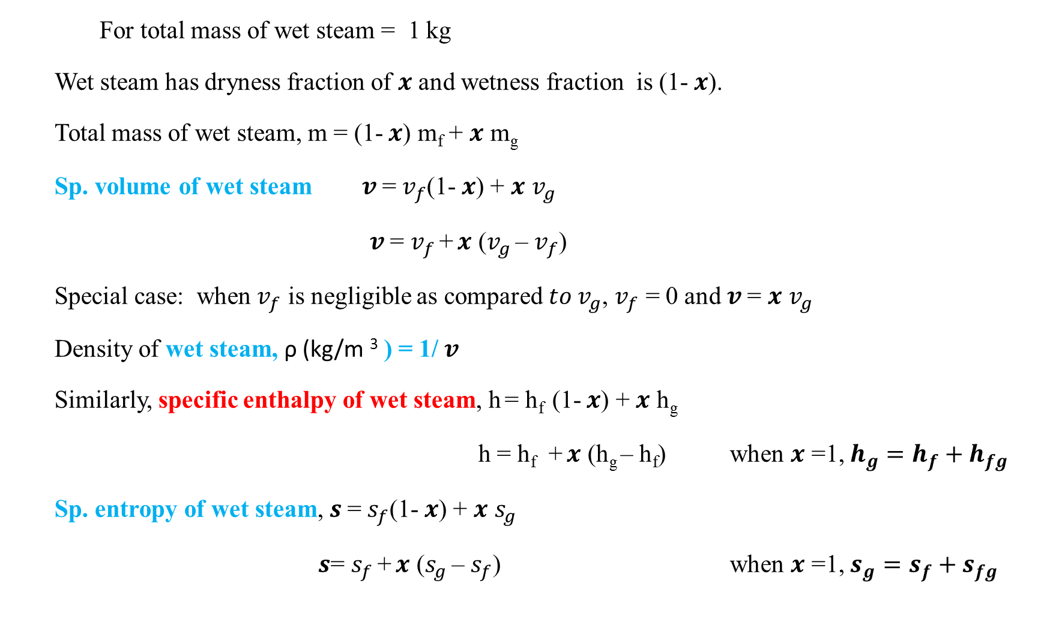
Some properties relationships for wet steam
For total mass of wet steam = 1 kg
Wet steam has dryness fraction of $x$ and wetness fraction is (1- $x$).
Total mass of wet steam, m = (1- $x$) m_{f} + $x$ m_{g}
Sp. volume of wet steam $v$= $v_{f}$(1- $x$) + $x$ $v_{g}$
$v$= $v_{f}$ + $x$ ($v_{g}$ – $v_{f}$)
Special case: when $v_{f}$ is negligible as compared ${to v}_{g}$, $v_{f}$ = 0 and $v$= $x$ $v_{g}$
Density of wet steam, ρ (kg/m ³ ) = 1/ $v$
Similarly, specific enthalpy of wet steam, h = h_{f} (1- $x$) + $x$ h_{g}
h = h_{f} + $x$ (h_{g} – h_{f}) when $x$ =1, $h_{g}=h_{f}+h_{fg}$
Sp. entropy of wet steam, $s$= $s_{f}$(1- $x$) + $x$ $s_{g}$
$s$= $s_{f}$ + $x$ ($s_{g}$ – $s_{f}$) when $x$ =1, $s_{g}=s_{f}+s_{fg}$

Slide 27

Dryness fraction and property relationships
Subscript f = saturated liquid
g = saturated vapour
m = m_{f} + m_{g} V = V_{f} + V_{g} V/ m = V_{f}/m + V_{g} /m = $v_{f}$* m_{f} /m + $v_{g}$ * m_{g} /m
$v_{f}$ = V_{f} / m_{f} $v$= $v_{f}$(1-x) + x $v_{g}$
$v_{g}$= V_{g} / m_{g} $v$= $v_{f}$ + x ($v_{g}$ – $v_{f}$)
m/m = m_{f} /m + m_{g}/ m
1 = m_{f} /m + x
m = (1- $x$) m_{f} + $x$ m_{g}
h = h_{f} (1-x) + x h_{g}
h = h_{f} + x (h_{g} – h_{f}) when x =1, $h_{g}=h_{f}+h_{fg}$

Slide 28
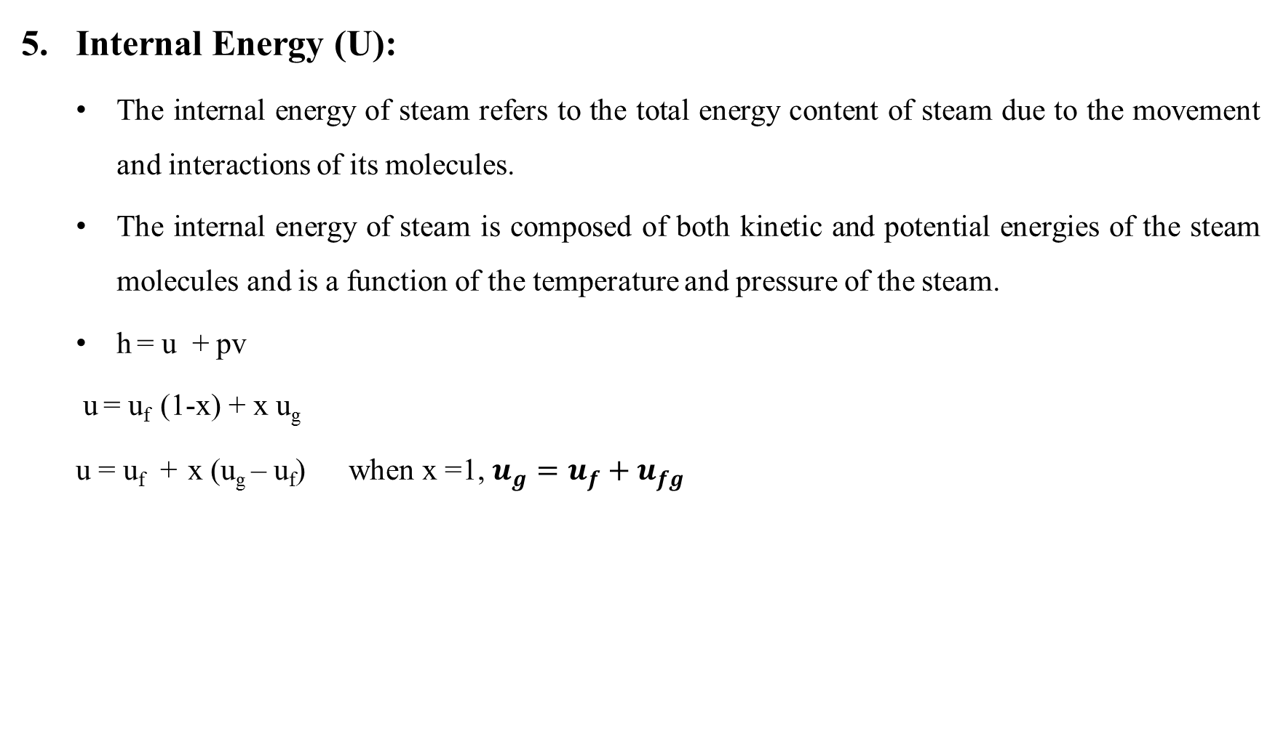
Internal Energy (U):
The internal energy of steam refers to the total energy content of steam due to the movement and interactions of its molecules.
The internal energy of steam is composed of both kinetic and potential energies of the steam molecules and is a function of the temperature and pressure of the steam.
h = u + pv
u = u_{f} (1-x) + x u_{g}
u = u_{f} + x (u_{g} – u_{f}) when x =1, $u_{g}=u_{f}+u_{fg}$

Slide 29
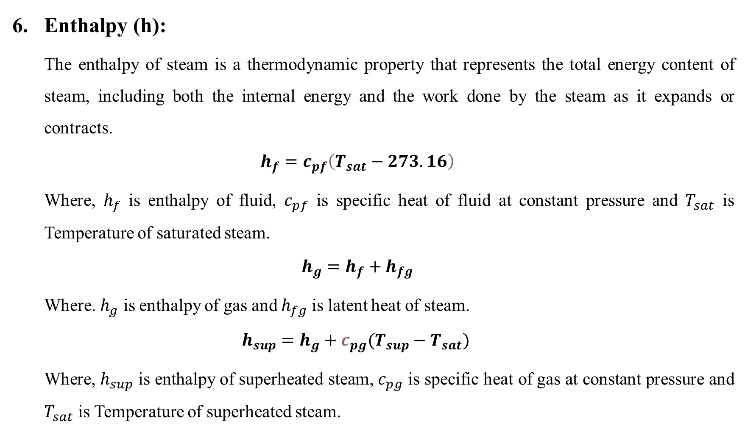
Enthalpy (h):
The enthalpy of steam is a thermodynamic property that represents the total energy content of steam, including both the internal energy and the work done by the steam as it expands or contracts.
$$h_{f}=c_{pf}\left(T_{sat}−273.16\right)$$
Where, $h_{f}$ is enthalpy of fluid, $c_{pf}$ is specific heat of fluid at constant pressure and $T_{sat}$ is Temperature of saturated steam.
$$h_{g}=h_{f}+h_{fg}$$
Where. $h_{g}$ is enthalpy of gas and $h_{fg}$ is latent heat of steam.
$$h_{sup}=h_{g}+c_{pg}(T_{sup}−T_{sat})$$
Where, $h_{sup}$ is enthalpy of superheated steam, $c_{pg}$ is specific heat of gas at constant pressure and $T_{sat}$ is Temperature of superheated steam.

Slide 30
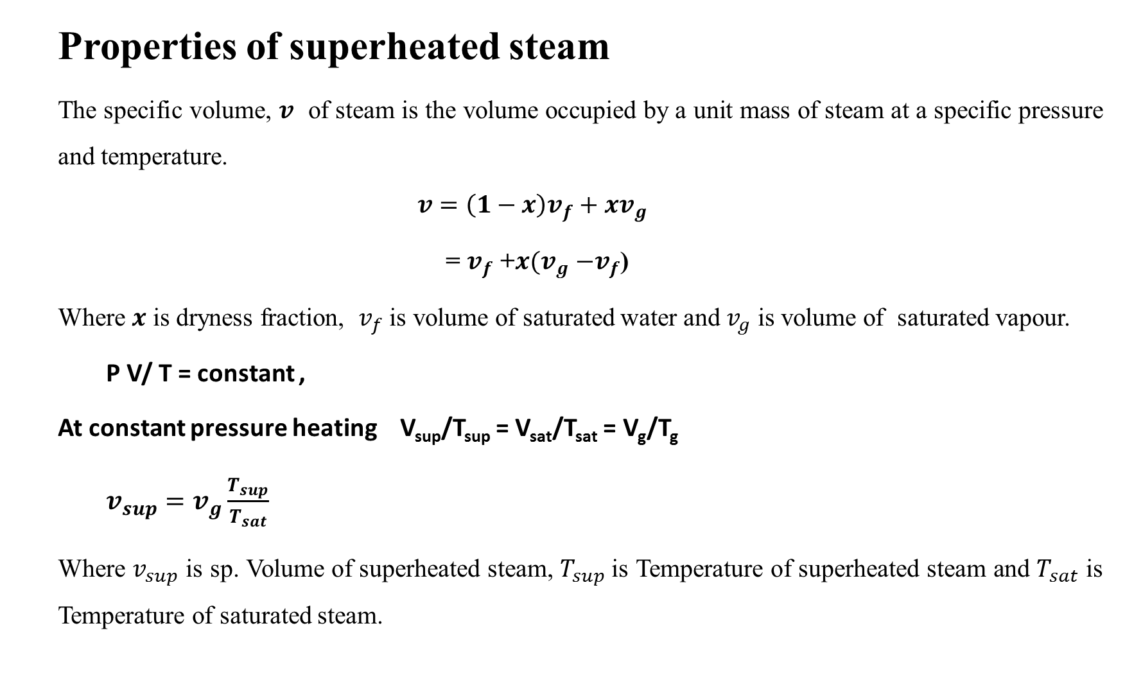
Properties of superheated steam
The specific volume, $v$ of steam is the volume occupied by a unit mass of steam at a specific pressure and temperature.
$$v=\left(1−x\right)v_{f}+xv_{g}$$
= $v_{f}$ +$x{(v}_{g} −v_{f}$)
Where $x$ is dryness fraction, $v_{f}$ is volume of saturated water and $v_{g}$ is volume of saturated vapour.
P V/ T = constant ,
At constant pressure heating V_{sup}/T_{sup} = V_{sat}/T_{sat} = V_{g}/T_{g}
$v_{sup}=v_{g}\frac{T_{sup}}{T_{sat}}$
Where $v_{sup}$ is sp. Volume of superheated steam, $T_{sup}$is Temperature of superheated steam and $T_{sat}$ is Temperature of saturated steam.

Slide 31
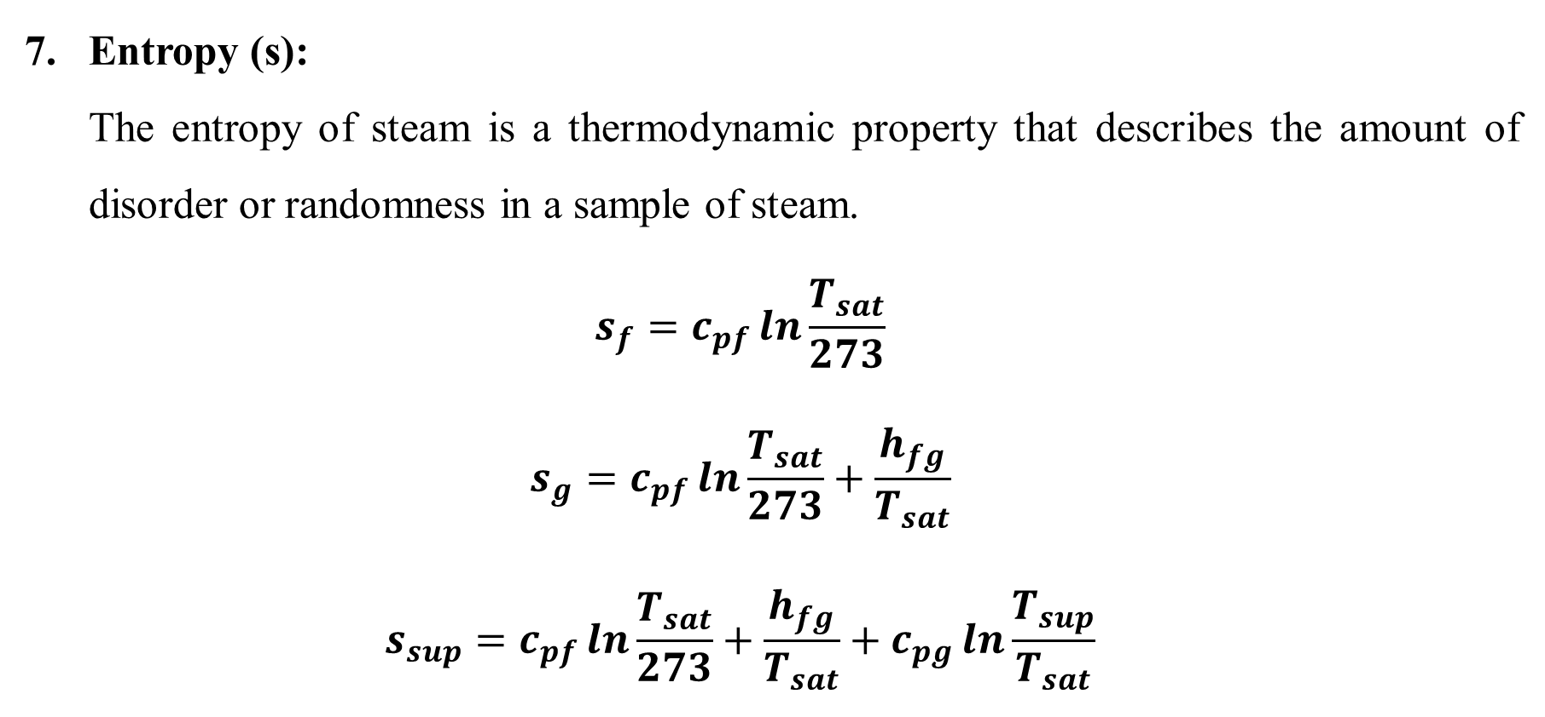
Entropy (s):
The entropy of steam is a thermodynamic property that describes the amount of disorder or randomness in a sample of steam.
$$s_{f}=c_{pf}\ln{\frac{T_{sat}}{273}}$$
$$s_{g}=c_{pf}\ln{\frac{T_{sat}}{273}}+\frac{h_{fg}}{T_{sat}}$$
$$s_{sup}=c_{pf}\ln{\frac{T_{sat}}{273}}+\frac{h_{fg}}{T_{sat}}+c_{pg}\ln{\frac{T_{sup}}{T_{sat}}}$$

Slide 32
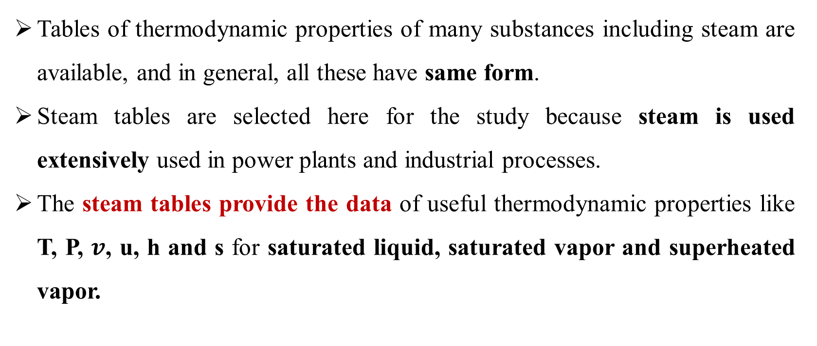
Why Steam Tables?
Tables of thermodynamic properties of many substances including steam are available, and in general, all these have same form.
Steam tables are selected here for the study because steam is used extensively used in power plants and industrial processes.
The steam tables provide the data of useful thermodynamic properties like T, P, $v$, u, h and s for saturated liquid, saturated vapor and superheated vapor.

Slide 33
Reference in Steam Tables
Since the properties like internal energy, enthalpy and entropy of a system cannot be directly measured (at a point); they are related to change in the energy of the system.
Hence one can determine Δu, Δh, Δs, (for a process) but not the absolute values of these properties (at a point). Therefore, it is necessary to choose a reference state to which these properties are arbitrarily assigned some numerical values.
For water, the triple point (T = 0.01º C and P = 0.6113 kPa) is selected as the reference state, where the internal energy and entropy of saturated liquid are assigned a zero value.

Slide 34
About saturated steam tables - Few Important Points
In the saturated steam tables,
the properties of saturated liquid that is in equilibrium with saturated vapor are presented.
During phase transition, the pressure and temperature are not independent of each other.
If the temperature is specified, the pressure at which both phases co-exist in equilibrium is equal to the saturation pressure.
Hence, it is possible to choose either temperature or pressure as the independent variable, to specify the state of two­ phase system.

Slide 35
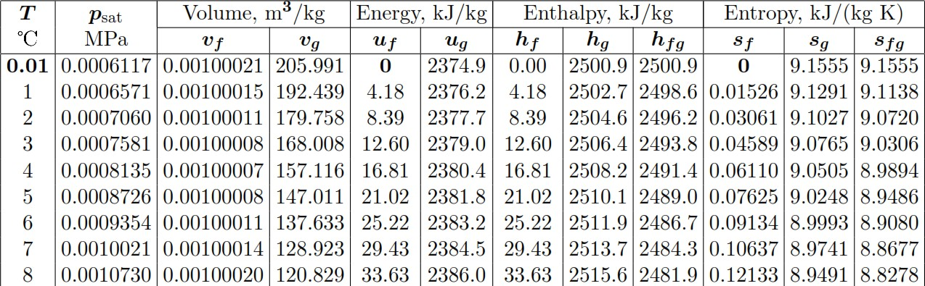
Steam Tables (For Saturated fluids)
Properties of saturated water & saturated steam (based on saturation temperature)
Steam table -1: Independent variable is Saturation temperature
*Linear interpolation may be done for the intermediate values

Slide 36
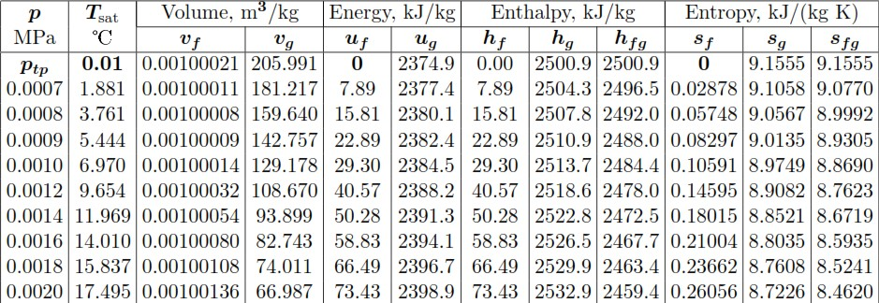
Steam Tables (For Saturated fluids)
Properties of saturated water & saturated steam (based on saturation pressure)
Steam table -2: Independent variable is Saturation pressure
*Linear interpolation may be done for the intermediate values

Slide 37
Steam Table- For Saturated fluids
Depending on whether the temperature or pressure is used as the independent variable, the steam tables are called saturated temperature or pressure steam tables.
The two phases­ liquid and vapor can coexist in a state of equilibrium only up to the critical point.
Therefore, the listing of the thermodynamic properties of steam in the saturated steam tables ends at the critical point (374.15º C and 220.5 bar).

Slide 38
Superheated Steam Table
If the steam exists in only one phase (sub-cooled water or superheated steam), it is necessary to specify two independent variables, pressure and temperature, for the complete specification of the state.
Therefore, in the superheated steam tables, the properties­ v, u, h, and s­ are tabulated from the saturation temperature to some superheated temperature for a given pressure.

Slide 39
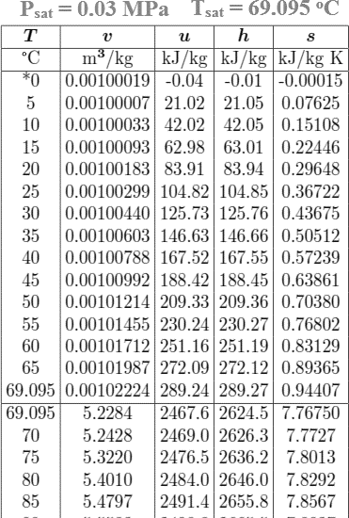
Properties of sub-cooled water depend not only on the pressure, but also on the degree of sub-cooling
Properties of superheated steam depend not only on the pressure, but also on the degree of superheat
Steam table -3: Gives the variation of properties of sub-cooled water and superheated steam
*Linear interpolation may be done for the intermediate values

Slide 40
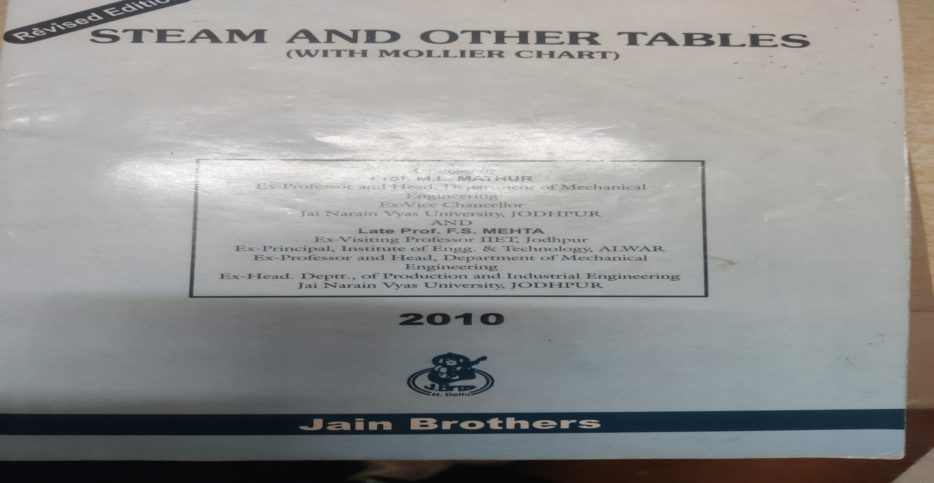

Slide 41
Mollier Diagram
Mollier chart is a graphical representation of steam table data in which y axis represents specific enthalpy ‘h’ (kJ/kg) and x axis represents specific entropy ‘s’ (kJ/kg).
State is defined by specifying any two intensive properties.
Observe: They have following lines:
Constant Enthalpy (Isenthalpic)
Constant Entropy (Isentropic)
Constant Pressure (Isobaric)
Constant Volume (Isochoric)
Constant Temperature (Isothermal)
Constant Dryness Fraction

Slide 42
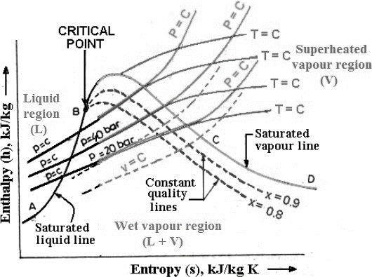
Mollier Diagram
Saturated vapour line (BCD) divides the chart into two regions
Wet vapour region is below saturated vapour line
Superheated vapour region is above saturated vapour line

Slide 43
Prob.1 Find the saturation temperature, the changes in specific volume and entropy change and the latent heat of vaporization of steam at 1 MPa.
Prob. 2 Saturated steam has an entropy of 6.76 kJ/kg-K. What are its pressure, temperature, specific volume and enthalpy?
Prob.3 Find the enthalpy and entropy of ateam when the pressure is 2 MPa and the specific volume is 0.09 m³/ kg.
Prob.4 Find the enthalpy, entropy and volume of steam at 1.4 MPa, 380ºC.

Slide 44
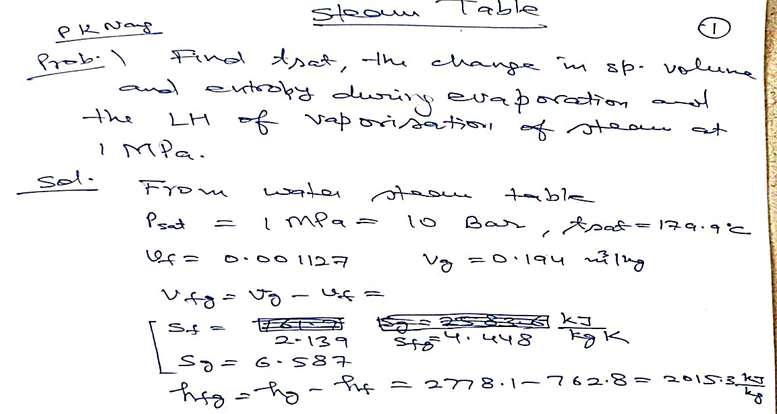

Slide 45
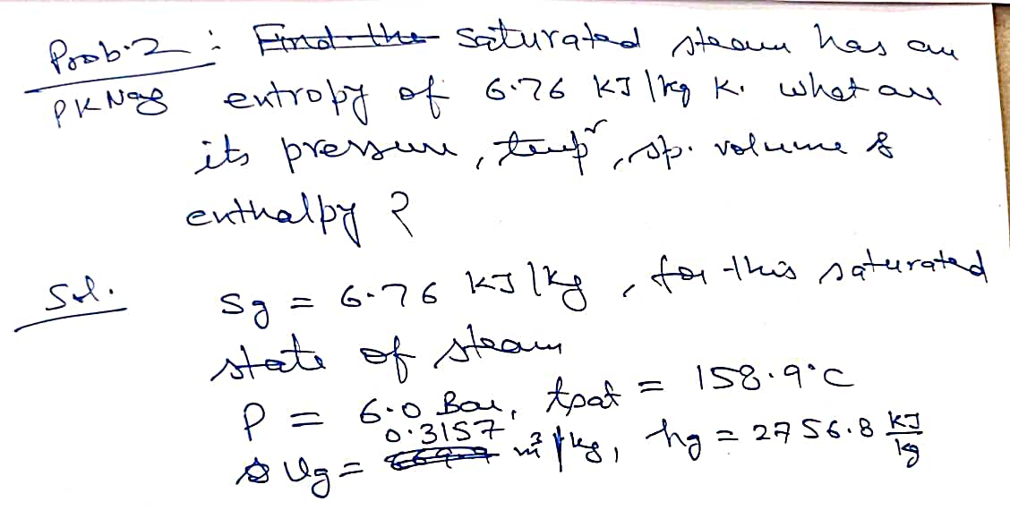

Slide 46
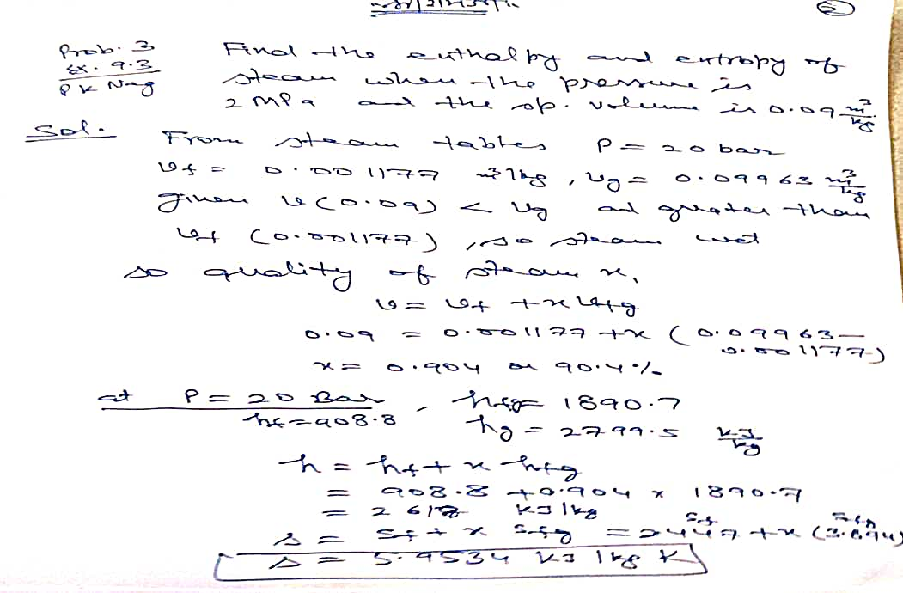

Slide 47
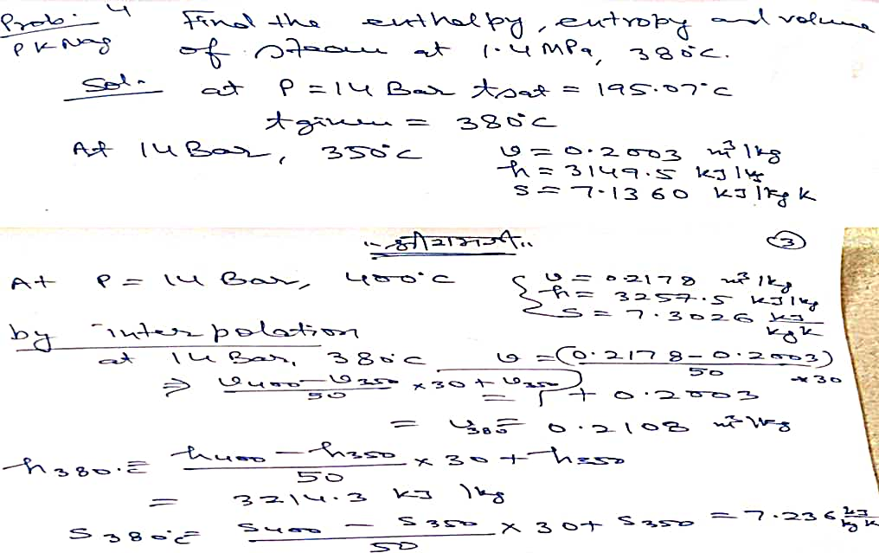

Slide 48
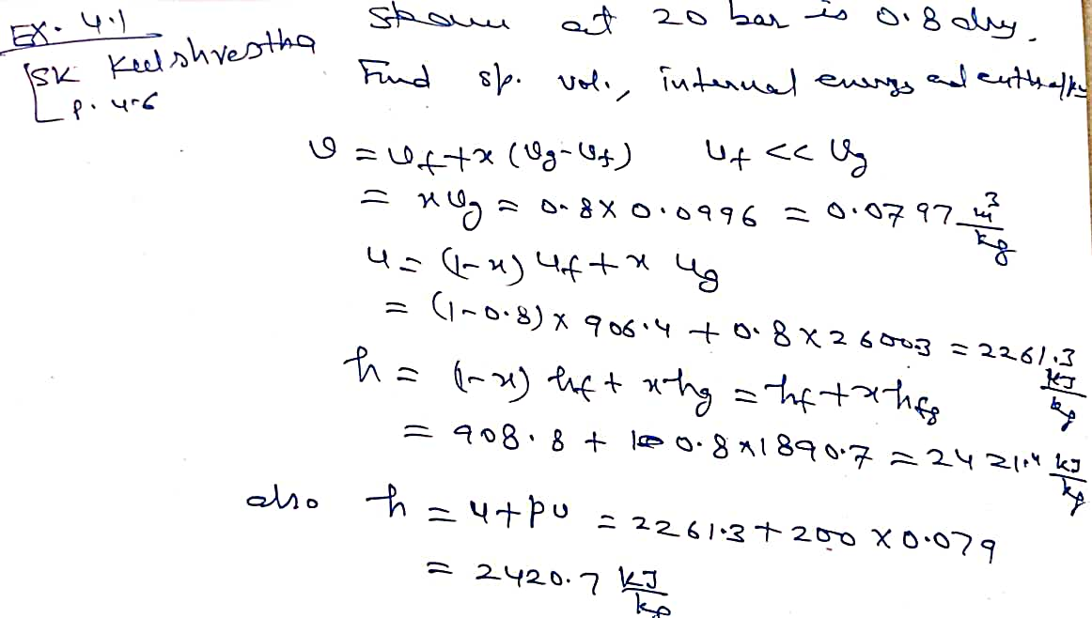

Slide 49
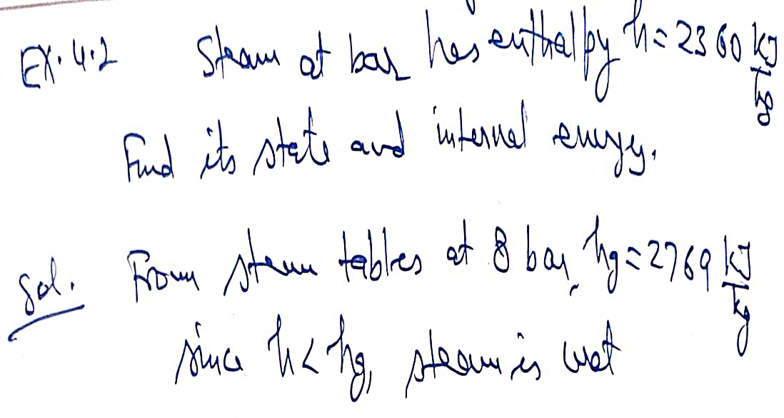

Slide 50
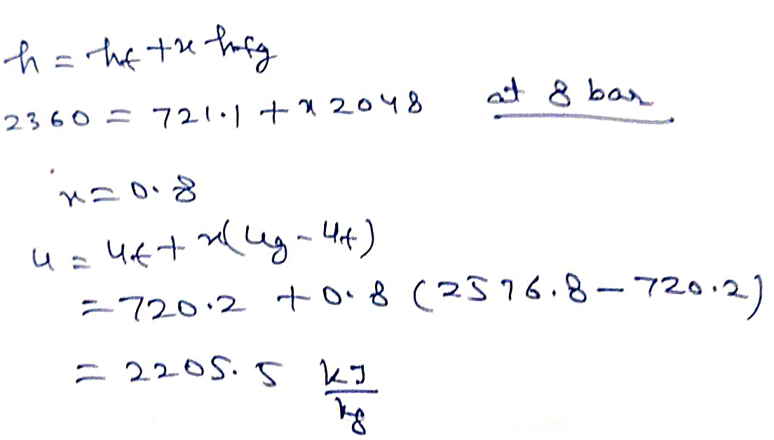

Slide 51
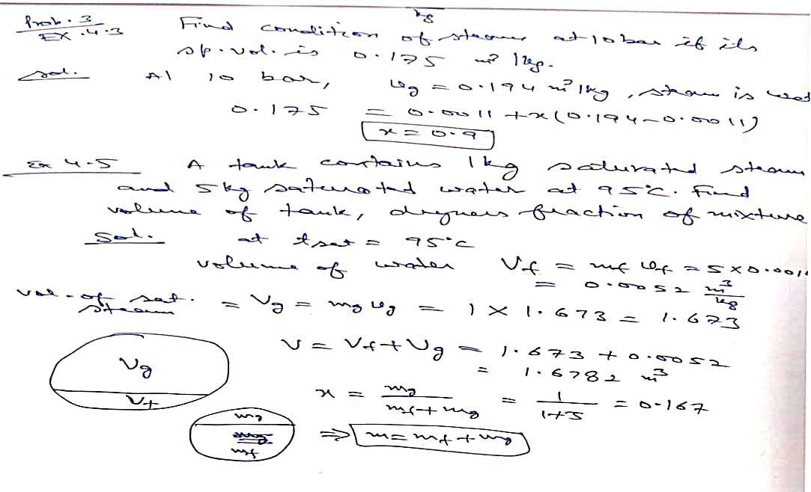

Slide 52
It is against the law of Nature
Doing the efforts at 30 to 50% level of our capacity and
Expecting 100% of Results
Is against the law of Justice or Nature

Slide 53
THANK YOU

